Slide 1
Introduction of Real-World Signals and Systems into ECpE DSP Laboratory Curriculum
Members:
Brady A. Max K.
Sam B. Emily L.
Mitchell H. Isaac R.
Team: SDDEC20-14
Advisor: Matthew Post
Client: Matthew Post Website: http://sddec20-14.sd.ece.iastate.edu/
Contact: Isaac Rex (irex@iastate.edu)
Notes:
Ren

Slide 2
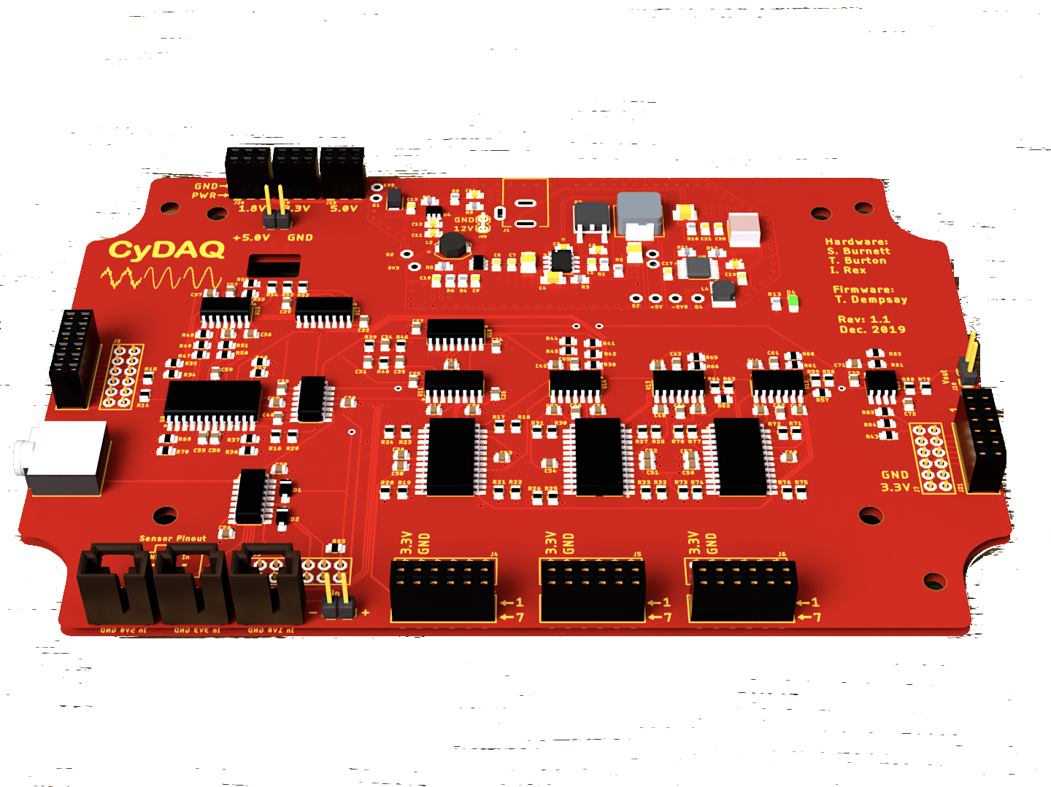
CyDAQ Recap
CyDAQ is a hardware teaching platform designed for EE 224/324 that contains onboard analog filters and interfaces for sampling data to a PC.
Our goal is to design labs and supplemental hardware that connect core concepts to real world hardware.
Figure 1: CyDAQ Board
Notes:
Max

Slide 3
Conceptual Sketch
CyDAQ
Software/Firmware
Hardware
Labs
Embedded
Signal Routing
EE 224 & 324
Graphical Interface
Sampling
Learning Objectives
FPGA
Band-limiting
Real-World Application
Notes:
Max

Slide 4
Goals
Create and submit lab documents for EE 324 and EE 224
EE 224 Labs & Final Project
3 completed, 1 nearing completion
4+ Labs for EE 324
1 completed, 1 nearing completion, 3 outlined
Final CyDAQ device revision
Expand sampling bandwidth with SPI differential ADC
Test implementation on eval board, anti-aliasing filter designed
Add SPI DAC to broaden application potential
Hardware added to eval board, firmware development in progress
Revise FPGA firmware to utilize FreeRTOS parallel processing
FreeRTOS doesn’t fit our use case; had success with an interrupt-based design
Notes:
Brady

Slide 5
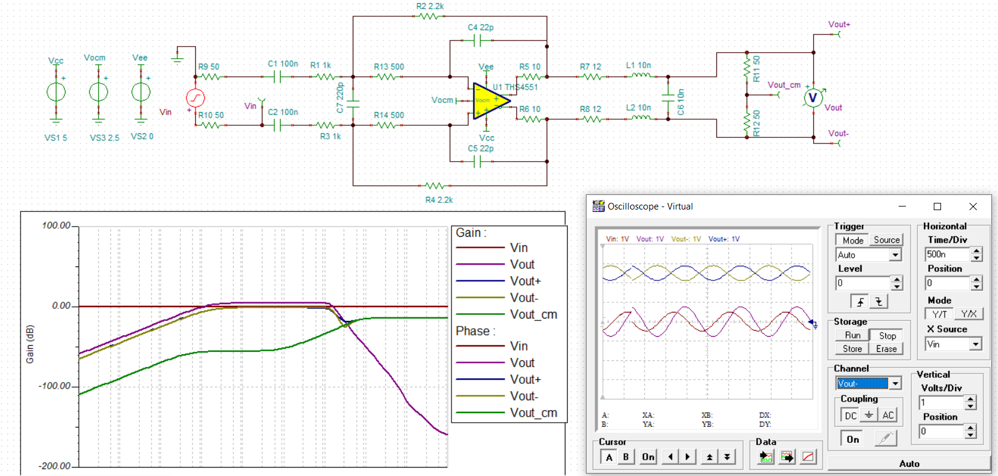
Technical Challenges
Hardware:
Completed Filter Design for ADC
Tested DAC and ADC evaluation module
Validated data conversion designs
Added DAC and ADC designs to main PCB and updated PMIC layout

Slide 6
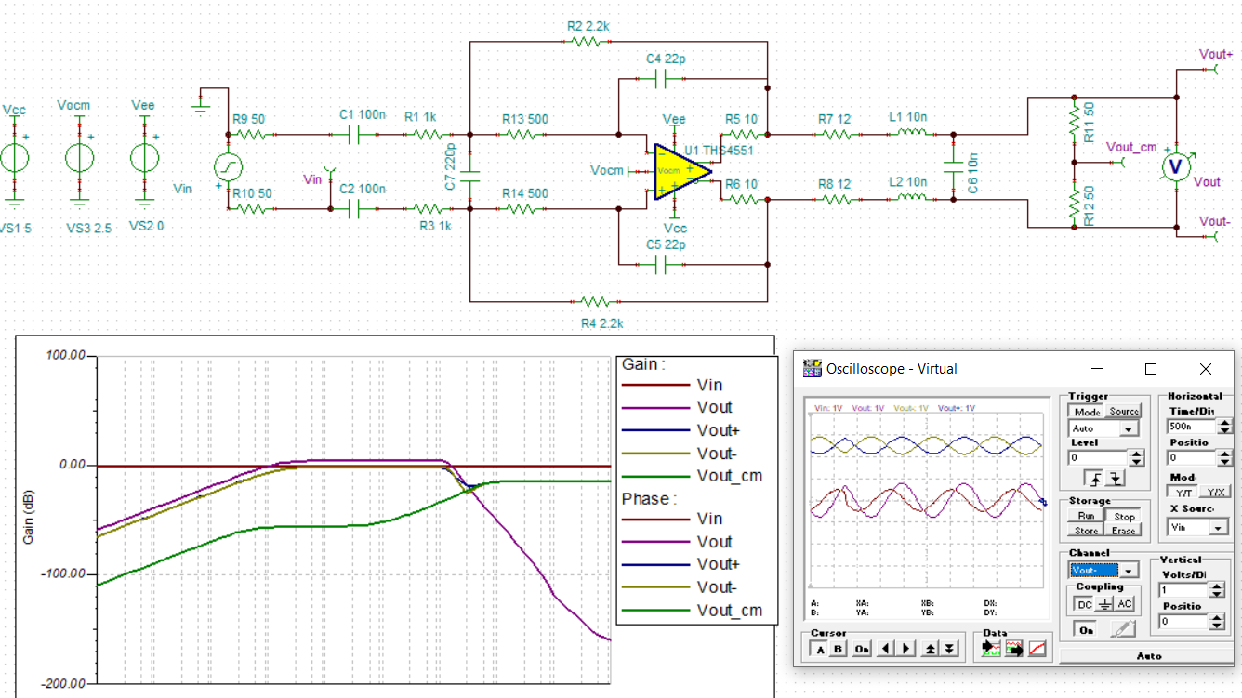
Technical Challenges & Progress: Anti - Aliasing Filter for ADC
Design:
2nd order multiple-feedback filter with 1st order LC low-pass
Fully differential, DC coupled to ADC
Shares common mode reference with analog measurement reference

Slide 7
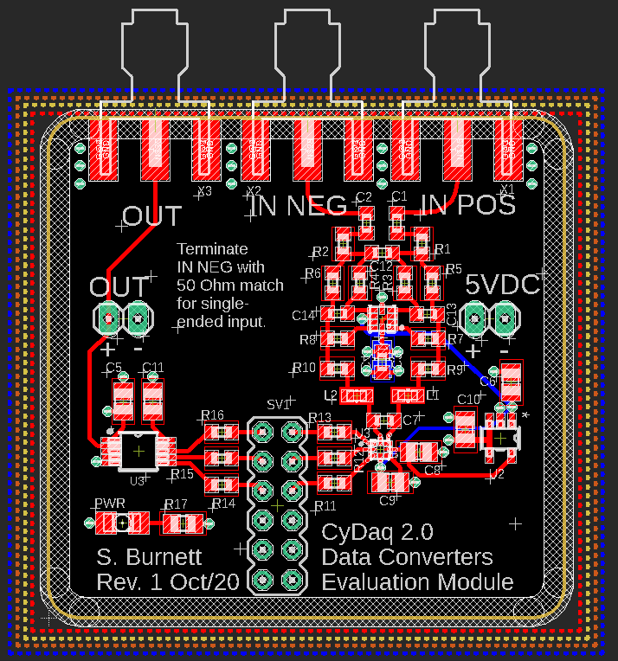
Technical Challenges & Progress: ADC and DAC Validation
Design:
Tested SPI communication
Sampled ADC input
Observed DAC output
Validated data bus design and protocol for both devices

Slide 8
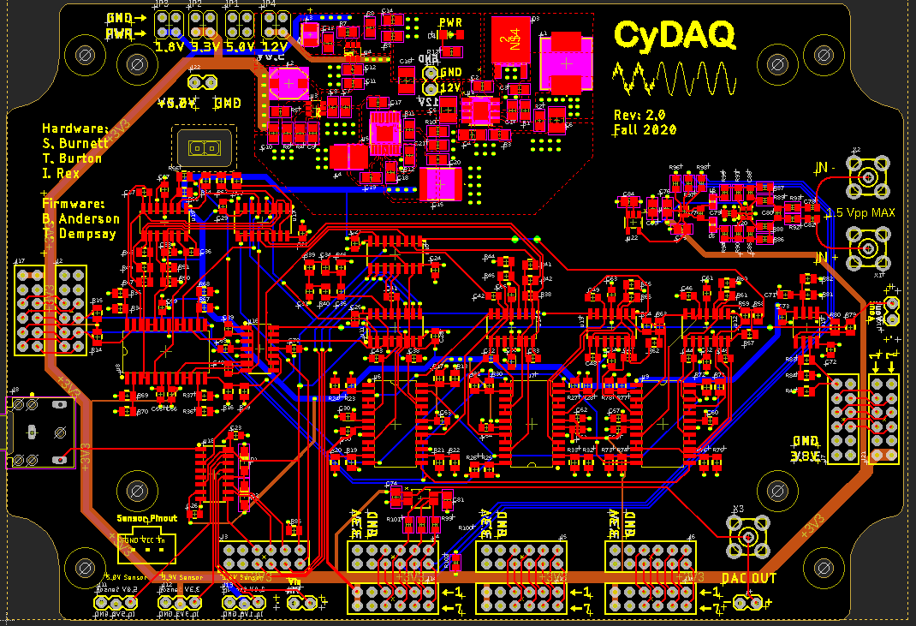
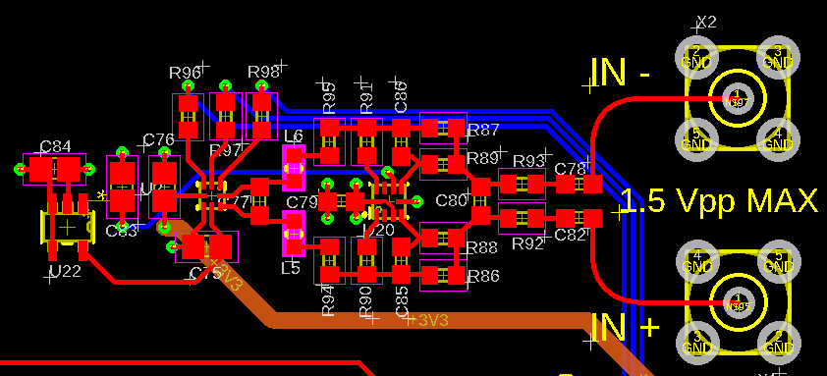
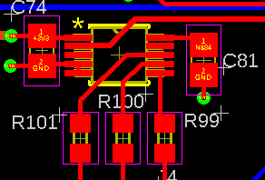
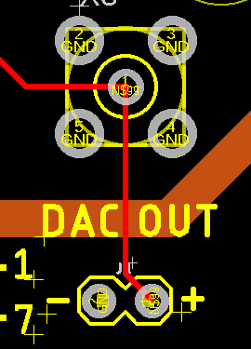
Technical Challenges & Progress: PCB Layout Revision
Layout Changes:
Condensed PMIC block
Integrated DAC input
Integrated ADC output

Slide 9
Technical Challenges & Progress: Software Systems
Firmware:
FreeRTOS determined insufficient
Task scheduler runs at 1kHz
Offers no benefits for a 1MHz+ sampling application
Interrupt-based firmware at feature parity
ISRs to process ADC and DAC operations
Passive loop to poll UART in background
SPI controller
Drive DAC and read external ADC
Added to FPGA fabric, configuration in progress
Notes:
Brady

Slide 10
Technical Challenges & Progress: User Interface
Connecting Python to MATLAB
Automatic Updates for Patches
Fetching instead of Streaming
Notes:
Mitch

Slide 11
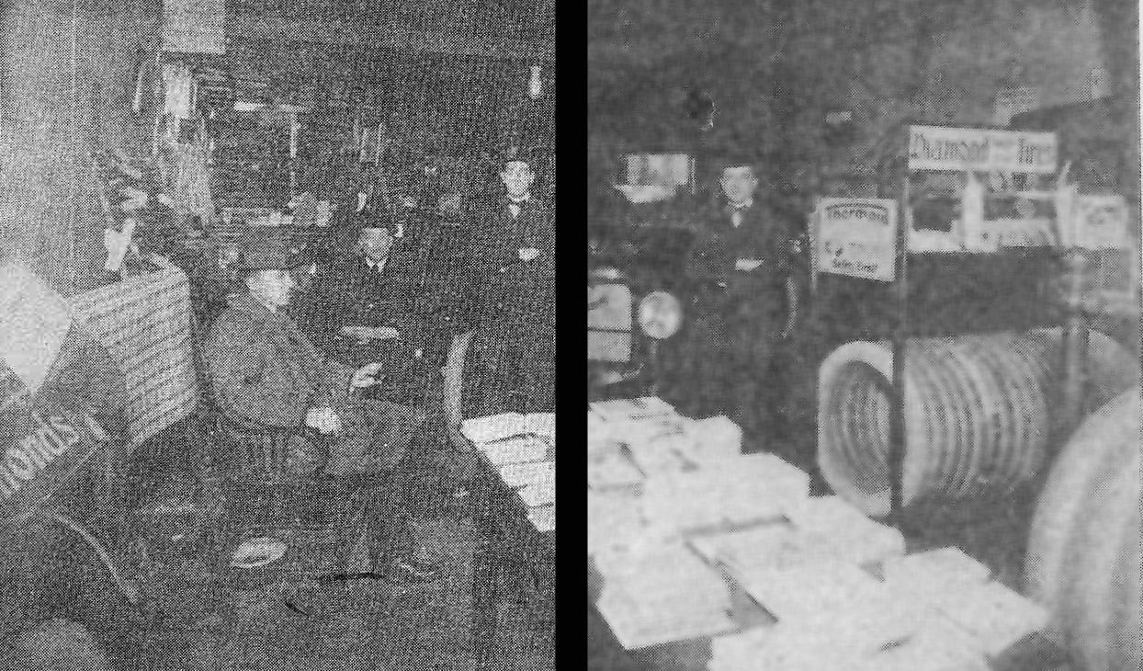
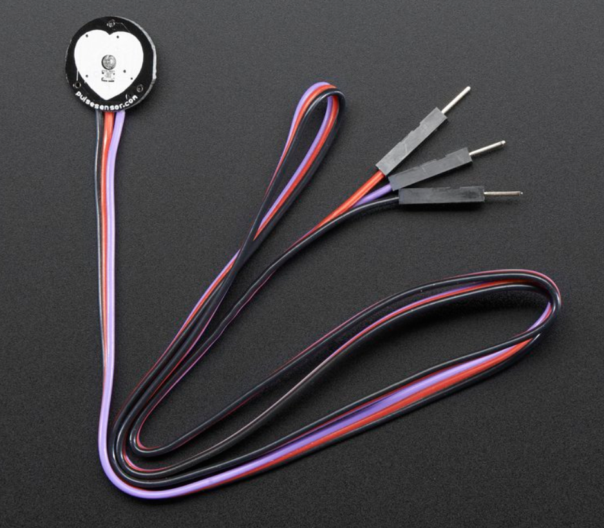
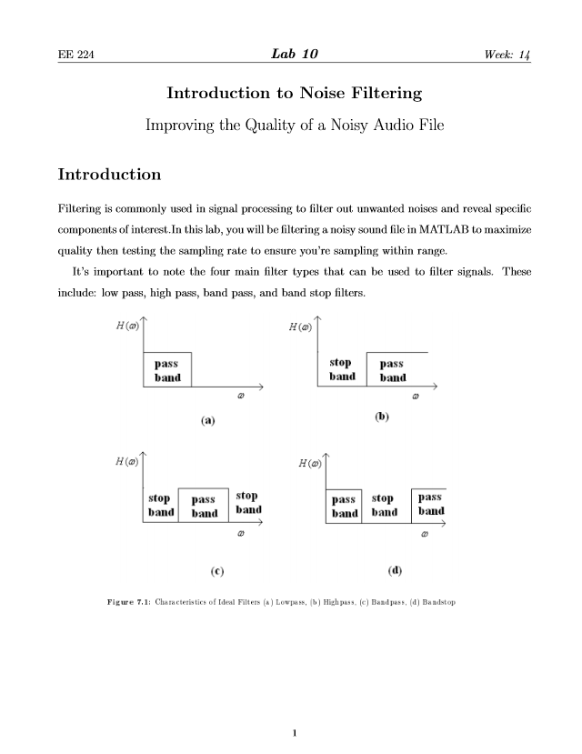
Technical Challenges & Progress
Labs:
Introduction to Noise Filtering
Filtering a noisy sound file
Identifying and implementing the correct filter using the CyDAQ
Heart Rate Project Lab
Open-ended design lab
Pulse Sensor input
Heart rate graph, BPM output
Completed: Image Restoration Lab
In-progress: Power Systems Design Lab for EE 324
Notes:
Ren

Slide 12
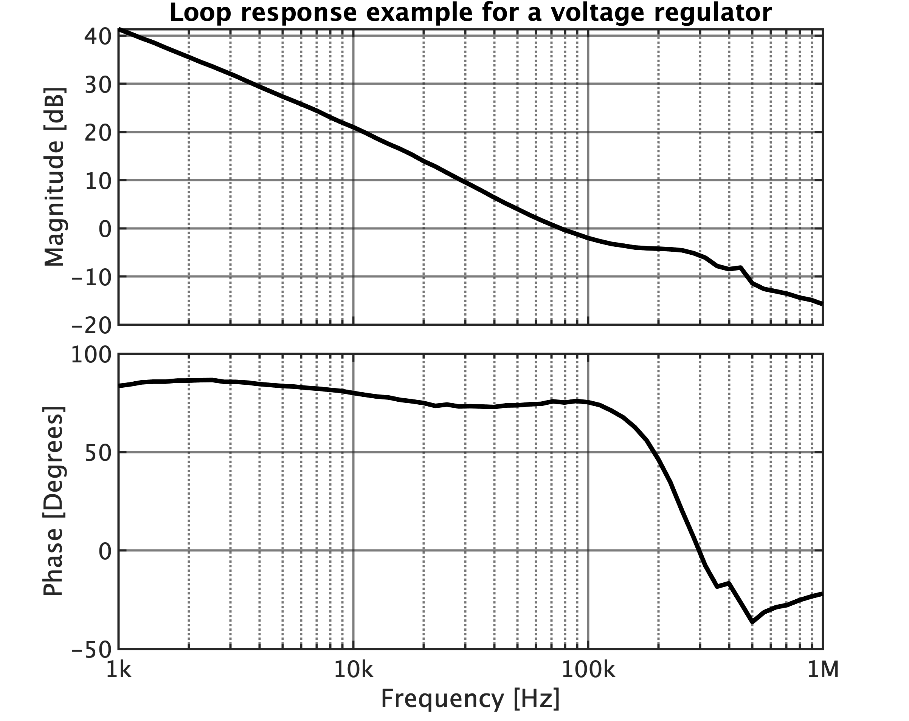
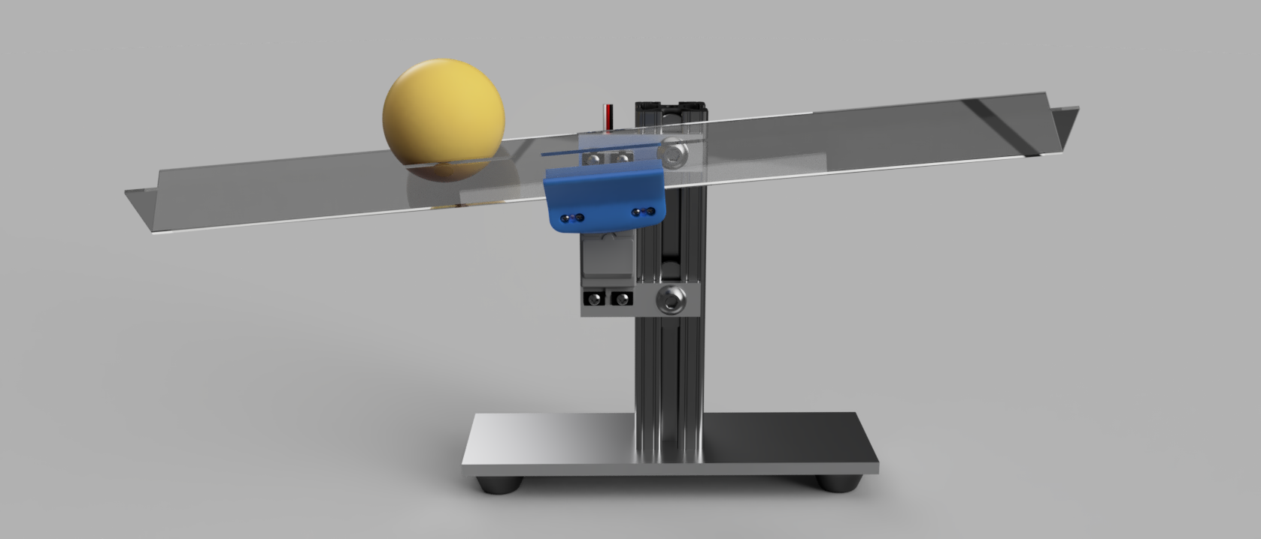
Technical Challenges & Progress
Labs:
Control Systems I: Measuring Loop Response
Parameter measurement
Power supply design
Control loop tuning
Application Notes
Control Systems II: Controller Design
System modeling and simulation
Tool-based controller design
Real implementation
Notes:
Isaac

Slide 13
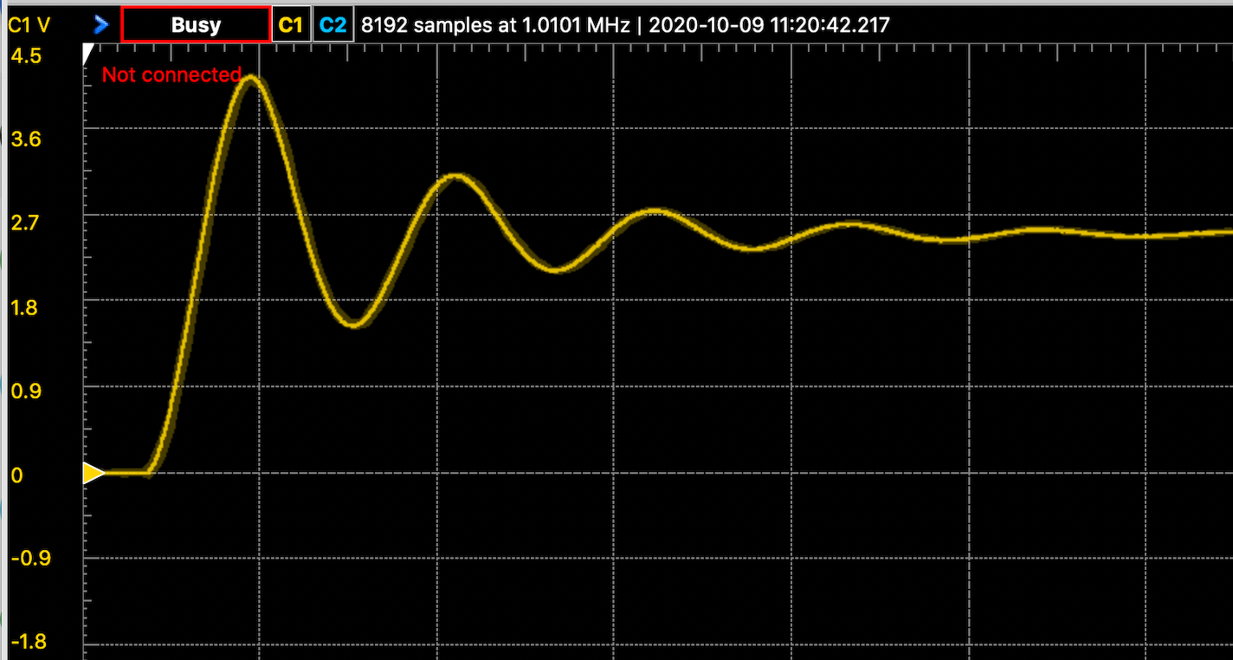
Technical Challenges & Progress
Labs:
System Dynamics From Differential Equations
Complete redesign of lab 1 for EE 324 to incorporate real world hardware
Mechanical spring system utilizing CyDAQ to sample data
Analysis of an RLC circuit, comparing theoretical and practical results
Deriving differential equations for lab models
Notes:
Max

Slide 14
Summary:
Finalized hardware updates
Delivered beta software for GUI and firmware backend
Completed several labs connecting theory to application
Thank you for listening!
Questions? Contact us at sddec20-14@iastate.edu
Notes:
Ren

